Slide 1
California Statewide Gas Emerging Technologies
Research Project Update
Cristalle Mauleon
Project Manager – Lincus Inc.
07/18/2023

Slide 2
Agenda
Project Goals
Project Outline
Project Findings
Q&A
Next Event

Slide 3
Today’s Speaker
Cristalle Mauleon

Slide 4
Program Overview

Slide 5
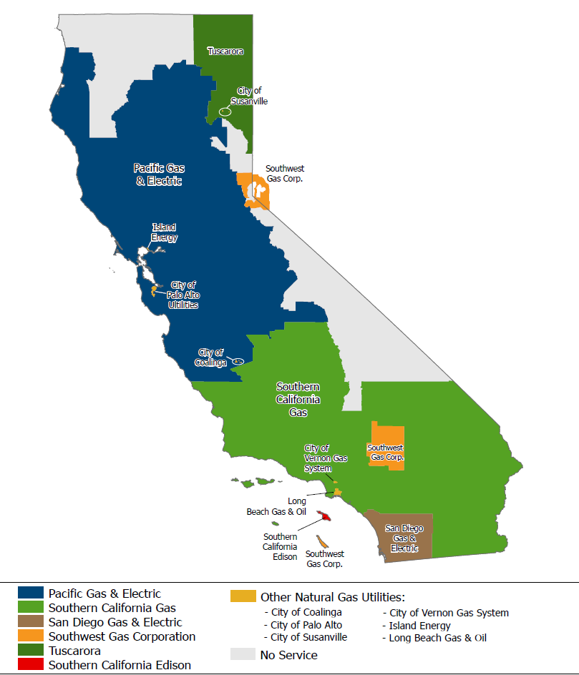
Background
Jointly funded by Southern California Gas Company, Pacific Gas and electric, and San Diego Gas and electric
Represents 11 million natural gas customers in California
Program launched in 2021
Research timeline 2022-2024

Slide 6
Project Goals

Slide 7
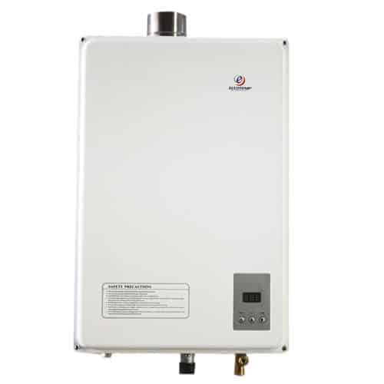
Project Goals
ET22SWG0002: Evaluation of Emerging Water Heater Technologies
Project Goal: Research emerging gas-fired water heating technologies through the lens of California market status and Energy Efficiency (EE) program policies to guide Gas Emerging Technology (GET) investments within those technologies.
Technologies: (6) emerging technologies
Gas Engine Heat Pump Water Heater (commercial)
Absorption Heat Pump Water Heater (commercial)
Adsorption Heat Pump Water Heater (residential)
Gas Engine Heat Pump Combi (commercial)
Absorption Heat Pump Combi (commercial)
Thermal Compression Heat Pump Combi (residential & commercial)
This Photo by Unknown Author is licensed under CC BY-NC
Notes:
Project #2 was focused on emerging water heating technologies. The goal of the project was to research emerging water heating technologies through the lens of California’s water heating market and EE programs so GET had a better idea of what technologies to invest research into. This project focused on 6 emerging technologies which are Gas Engine heat pump water heater in a commercial building. This is a vapor compression cycle that you would see in an electric heat pump, but it is run by a natural gas-fired internal combustion engine. Absorption heat pump water heater in a commercial setting. This is a refrigeration cycle that uses ammonia and water or Lithium Bromide and water to absorb and desorb the ammonia from the Water or the water from the Lithium Bromide. Adsorption Heat Pump Water heater in a residential setting which absorbs and desorbs using a dessicant, and a thermal compression heat pump combi system that can be used in residential and commercial. This uses a patented thermodynamic cycle to produce hot and cold water. The combi systems systems on this list mean that they can provide hot water for both domestic hot water and service hot water. The gas-engine and absorption systems both have a domestic hot water only or combination system option and each option is considered as its own technology even though it can use the same unit in practice.

Slide 8
Project Outline

Slide 9
Project Outline
ETSWG220001 - Research and Analyze Water Heating Technology Market & Current Trends
Project Initiation Meeting
Water Heating Technology Table (Phase 1)
Interview Subject Matter Experts
Water Heating Participation Trends (Phase 1)
Water Heating Participation Trends (Phase 2)
Compare Historical Trends with Statewide Potential
Cost, Simple Payback and Total System Benefit (TSB) Charts for (5) Opportunities
ETSWG220002 - Evaluation of Emerging Water Heater Technologies
Project Initiation Meeting
Emerging Technology Prioritization
Interview Subject Matter Experts (SMEs)
Emerging Technology Additional Info
High-Level Energy Savings
Total Resource Costs (TRC), and Total System Benefits (TSB)
Related
Parallel
Notes:
REVISE: This project was done in parallel with another one on emerging water heating technologies and has some related tasks. This project first created a water heating technology table which was an expansion of the technology priority map or TPM. This Water heating technology table was then used in the other water heating project. Next, subject matter expert or SMEs interviews were done for both projects. 16 SMEs were interviewed across both projects and the results were analyzed. After SME interviews were done, we looked at CEDARS data to see the participation trends in water heating in task 4 and then had some conversations with SoCalGas program staff and a couple of contractors and we did some additional analysis on AQMD, Energy Star, and Incentives to try and understand the trends that we saw in Task 5. In task 6 we compared the historical trends from CEDARS to the 2021 Potential and Goals study. In Task 7 we looked at 5 measures which had an opportunity to improve their participation and we did some analysis to see what the customer costs, simple payback and TSBs would look like for different incentives.

Slide 10
Project Task Findings

Slide 11
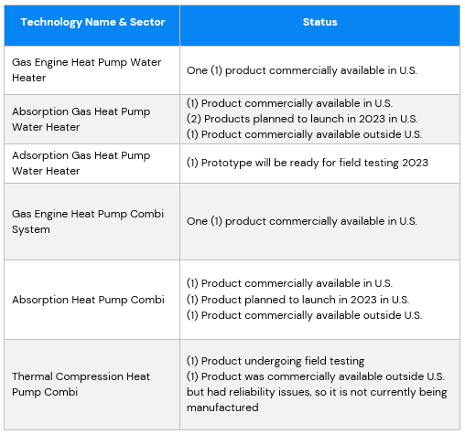
Project Findings – ET Technology Prioritization – High Priority
Started with (17) Emerging Technologies from WHTT:
Prioritized by
Program
Customer
Market
Regulatory
Ended with (6) high-priority technologies:
Gas Engine Heat Pump Water Heater
Absorption Gas Heat Pump Water Heater
Adsorption Gas Heat Pump Water Heater
Gas Engine Heat Pump Combi
Absorption Gas Heat Pump Combi
Thermal Compression Gas Heat Pump Combi
Notes:
The first task in this project was to take the (17) emerging water heating technologies from the water heating technology table and prioritize them to whittle them down to only 6 high priority technologies for which further study would be done. The prioritization was done using criteria related to EE programs, customers, the market, and regulatory.

Slide 12
Project Findings – Subject Matter Experts
(16) Interviews conducted across multiple categories:
(7) Manufacturers
(2) Technical Experts
(6) Installers/Contractors
(1) Technology Distributor
Experts recruited from:
Hot Water Forum
Midstream Water Heating Participating Distributors
SCAQMD Rule 1146.2 & Rule 1121 List of Certified Units
Previous professional relationships
Notes:
These are the findings from the Subject Matter Expert Interviews. We interviewed water heating experts to gather current market information about existing and emerging water heaters. They were recruited from the Hot Water Forum contact list, the list of midstream participating distributors, South Coast AQMD’s list of certified units for some of their rules, and through previous relationships with GET team members. When the task was finished a total of 16 interviews were completed and you can see the breakdown of the type of expert on the slide. Each expert was asked 32 questions. 16 questions were about drivers for high efficiency and emerging water heating drivers, and 16 were about barriers.

Slide 13
Project Findings – Subject Matter Experts
Key Findings:
Barriers – Overall Survey
High initial costs
Lack of awareness
Lack of trained installer and maintenance personne
Additional Barriers – (7) ET Manufacturers
General adverse regulatory environment for gas technologies
Drivers
Independent verification of performance
Improved performance
Environmental compliance
This Photo by Unknown Author is licensed under CC BY-NC-ND
This Photo by Unknown Author is licensed under CC BY-NC-ND
Notes:
This slide shows the key barriers and drivers found from the interviews. Top three barriers from the overall survey with all 16 SMEs were high initial costs of equipment, lack of awareness by customers or installers about the high efficiency or emerging equipment, and lack of trained installer and maintenance personnel. The lack of awareness and lack of training were more pronounced for the emerging technologies as would be expected. Additionally, the emerging technology manufacturers also felt very strongly that the general adverse regulatory environment for gas was a significant barrier to installation. The drivers for participation were independent verification of performance of the water heaters, improved performance of the high efficiency and emerging water heaters over the incubments, and environmental compliance with things like AQMD regulations.

Slide 14
Additional Information on High Priority Technologies
Codes & Standards:
AQMD impacts all technologies (except Gas-Engine)
Title 24/Title 20 impact Gas Engine and Absorption
Zero Net Energy:
Thermal Compression requires least solar offset
Absorption requires the most thermal offset
DAC/HTR:
Adsorption may be able to participate
Inconclusive on others
Notes:
Once the high priority technologies were selected, we gathered some additional information related specifically to the California EE market. This information was on Codes & Standards, Zero Net Energy, and DAC/HTR. It was important to find out what codes & standards in California could affect the emerging water heaters so we looked into AQMD, Title 20 and Title 24. AQMD limits the Nox on all water heaters except the gas-engine water heater. The gas engine water heater is under 50 hp so that’s why it was not regulated by AQMD. Title 24 regulates the minimum COP of the gas- engine water heater and combi and Title 20 regulates the minimum UEF of the adsorption water heater. We also wanted to see how Net Zero Energy targets would impact these technologies so we calculated the solar offset that would be required for each technology as a percentage of the building footprint. Thermal compression requires the least amount of solar offset and the absorption water heater and combi requires the most solar offset. These values were calculated using estimated energy savings used during the prioritization in Task 2. We also wanted to see if any of these technologies could participate in a DAC program or at a hard-to-reach customer site. We used the HTR_DI Net to gross IDs in the CEDARS data to look at the measure costs for water heating that have participated in Hard to reach customer sites. This NTG ID was a proxy for DAC since DAC status is one of the qualifiers for hard-to reach. We found that the adsorption heat pump water heater cost seems to be in line with costs for tankless water heaters that have participated in hard to reach direct install programs, so this water heater might be able to participate in hard to reach or DAC programs as well. We did not have enough information in the multifamily or commercial markets to make conclusions on the other technologies.

Slide 15
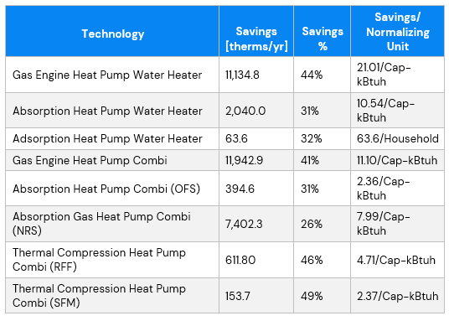
High Priority Technologies: Energy Savings
Methodology:
DEER Water Heater Calculator
MAS Control Model Information
Methodology:
Third-party data: Gas Engine, Absorption (1 manufacturer)
Manufacturer: Absorption, Thermal Compression
Calculations:
Absorption Combi
Thermal Compression Combi
Notes:
Moving on to Task 5 of project #2. We took the 6 high priority technologies and found usable performance data from field studies or manufacturers and put it into calculations to determine high level energy savings for each technology. All of these technologies except the absorption unit will have COPs that are a function of the outside air temperature. The methodology used follows the DEER water heater calculator and modifies it so that the hourly COP based on the outside air temperature is used to calculate the hourly energy use. In the combi systems, we got hourly heating loads from MAS control models. The absorption water heater was rated using a Uniform Energy Factor rather than a COP. Single family water heaters use UEF as their efficiency value and this is converted into a recovery efficiency in the DEER water heating calculator. So, for that specific unit, we converted the manufacturers UEF into an equivalent recovery efficiency and did not change anything in the DEER water heater calculator. We got third-party data from field studies by NEEA for the gas engine and absorption units. There was some third party data available for another manufacturers absorption unit, but it was in a residential setting and was not as easy to use, so we decided to just use the Robur data. Adsorption UEF came from the manufacturer and the Thermal compression COP was a single COP at a single outside air temperature from a DOE study. This COP was derated with lower outside air temperatures based on the COP changes with outside air temperature for the other units. So, the savings for the adsorption and thermal compression units need to be taken with a grain of salt because they are not lab or field verified values. We decided to do a total of 8 calculations for the 6 technologies so that we could calculate the savings for the same technology in two different building types. The two calculations were done adsorption combi in an small office and a nursing home and for thermal compression in a fast food restaurant and a single family home. You can see that the thermal compression unit has the highest percentage of savings and the absorption water heater and combi unit have the lowest percentage of savings. The adsorption savings of 32% is very good for a single family home water heater.

Slide 16
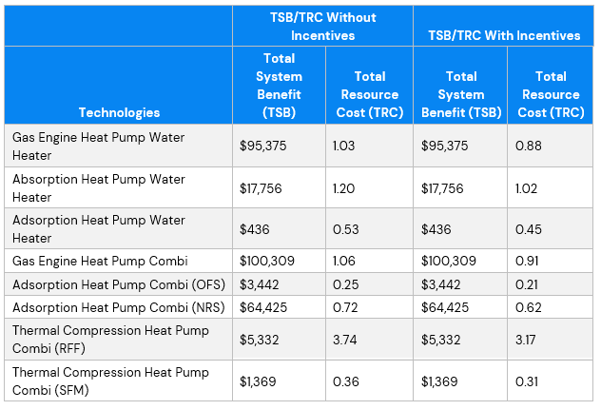
High Priority Technologies: TRC/TSB
Cost:
Measure Packages
Manufacturers
TRC/TSB Calculated With:
No Incentives
Incentives = measure cost
Notes:
Once we completed high level energy savings, we calculated TRCs and TSBS for each technology. We got standard measure costs for incumbent boilers or water heaters from measure packages and we got measure costs from manufacturers or studies. The installation configurations affect the measure case costs and the effective useful life in this calculation. For example, you could install an absorption unit alongside and existing boiler which would reduce your measure cost but would probably limit your useful life, or you could install in alongside new boilers which would increase your measure cost but would also increase your measure life. We assumed all of these units were installed alongside new condensing boilers so they could maximize their operating time and their useful life. We calculated the TRC without incentives and with incentives equal to 100% of the measure cost to give a full range of TRC. The Thermal compression combi unit in a fast food restaurant has the best TRC at 3.17 but remember this needs to be taken with a grain of salt due because savings are based on manufacturer performance data. The lowest TRC is for the adsorption combi and an office which indicates that the sizing of the absorption units needs to be done properly to maximize the absorption operating hours and minimize the measure cost per kbtu. The Adsorption water heater has a TRC less than 1, but it is for a single family home, and TRCS less than 1 are not uncommon for single family based upon some analysis we did of CEDARS data. The same goes for the thermal compression combi in a single family home. It’s TRC is also less than 1.

Slide 17
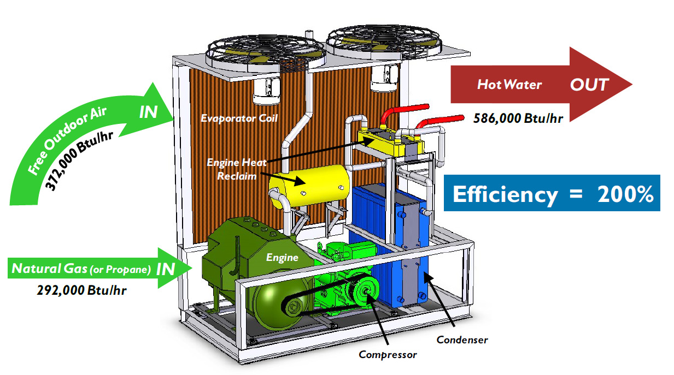
Gas Engine Heat Pump Water Heater and Combi
Not selected for future study
Pros
Does not currently trigger AQMD requirements being under 50hp
Systems can be modulated to meet DHW and/or HHW
TRCs close to 1.0
Cons
Highest upfront costs
Additional maintenance for gas engine
Low market share
Risk of AQMD regulation
Air-Source Gas Engine Heat Pump Water Heater and Combi
Notes:
Let’s discuss the findings for each technology. First up is the gas-engine heat pump water heater. We ultimately did not recommend this for further study. It didn’t trigger AQMD and it could modulate to the actual hot water load which were both pros. It also had TRCs close to 1 which is important. However, this system had the highest upfront cost and there is additional maintenance required for the gas engine that eats into the utility cost savings. That additional cost is not reflected in the TRCs but will impact customer decisions to install. The interview with the manufacturer for this unit indicated that the maintenance cost does impact the customer choosing this unit and the unit has very few installations nationwide. It is mostly installed where electrical service is unreliable or hard to get so we felt it had little market share in California. Further, although it is not currently regulated by AQMD, there is a risk that it could be if its market share started to increase.

Slide 18
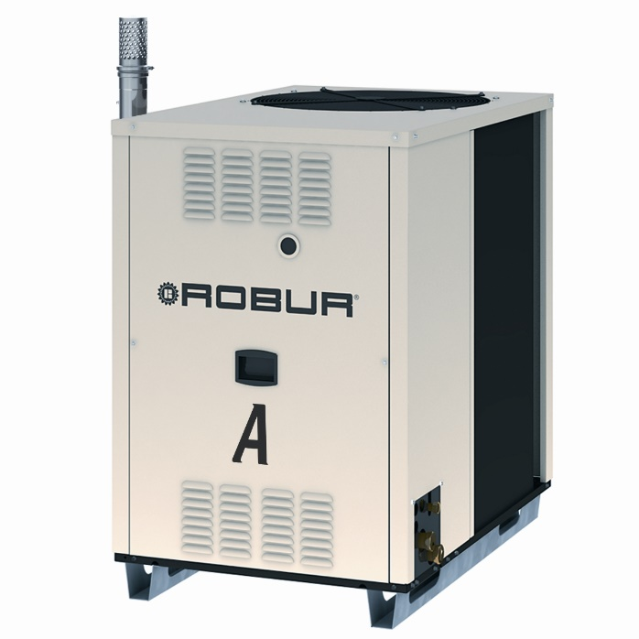
Gas Absorption Heat Pump (GAHP) Water Heater & Combi
Selected for future study
Pros
Applicable to many commercial buildings & multifamily buildings
TRC in water heating only mode is 1.02
Need for additional third-party data
Measure Package
Water Source Unit
(1) manufacturer willing to work with GET
Cons
Cannot modulate to load
0.21 TRC for OFS combi
Notes:
Next up with the absorption heat pump water heater and combi. This was recommended for further study. It is applicable to many commercial buildings and well as multifamily buildings. The TRC in water heating only is 1.02 and there was a need and opportunity for GET to gather third-party data for this unit. There is an existing measure package for this unit in multifamily for which the CPUC requires more data to be used to update the measure package when more data is available. Also, there have been no third party studies of the water source unit and we don’t know of any plans by other organization to study it. We found that for some of our other recommendations, the manufacturers are already working with other entities to test their products and they are not interested in having GET test them at this time. This manufacturer is easy to work with, there are gaps that need to be filled, and this has benefits for California EE programs. The drawback of this unit is that is cannot modulate to the actual water heating load and it can have low TRCs.

Slide 19
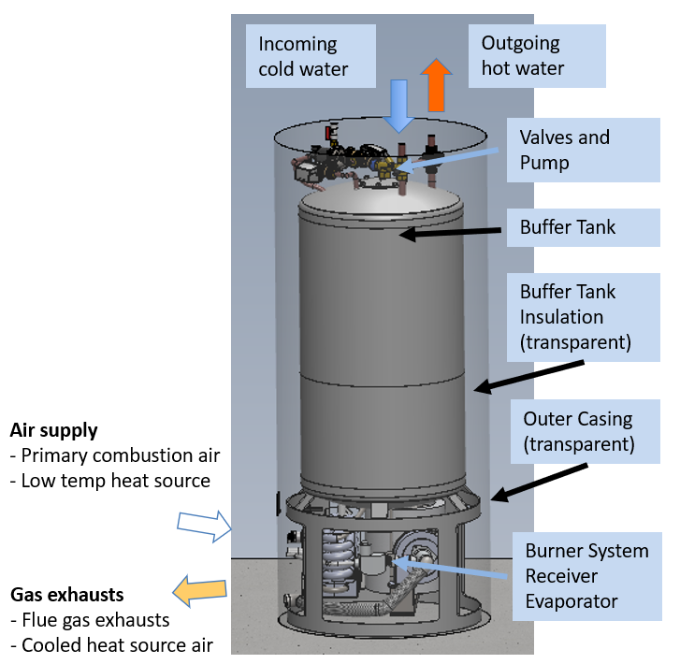
Absorption Gas Heat Pump Water Heater
Selected for future study based on:
Pros
Single-Family drop-in
Similar cost to tankless condensing
Needs third-party testing
Potential DAC/HTR technology
Cons
Not commercially available with no planned launch date yet
TRC < 1.25 (not uncommon for SF)
Adsorption Gas Heat Pump Water Heater
Notes:
Moving onto the adsorption unit, this was also recommended for further study. It is being designed as a single family drop in replacement with a similar cost to tankless condensing units which as a reminder have seen increased participation over the last few years. It needs third-party testing and it can potentially participate in a DAC or HTR program. However, it is not commercially available and there is not planned launch date. The TRC is low, but that isn’t uncommon for single family so we feel this is a good candidate for future studies. The manufacturer is currently working with GTI on performance data, so the GET program will stay in contact with them to see when we could do some testing to complement what others are doing.

Slide 20
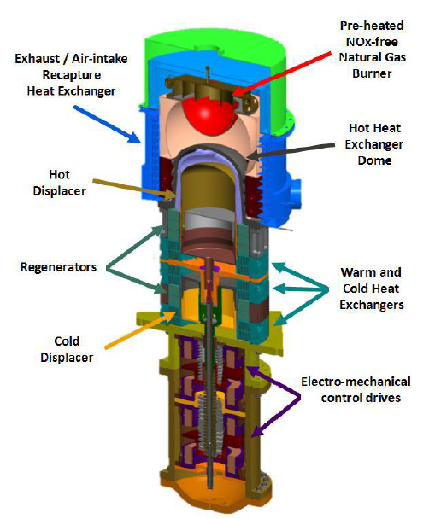
Thermal Compression Gas Heat Pump Combi
Selected for future study
Pros
Requires least amount of solar offset for ZNE
Hydrogen ready
TRC of 3.17 for RFF (with a grain of salt)
Needs third party testing
Cons
No range of performance data
TRC SF < 1.25 (not uncommon for SF)
High cost for SF
Notes:
Moving onto the adsorption unit, this was also recommended for further study. It is being designed as a single family drop in replacement with a similar cost to tankless condensing units which as a reminder have seen increased participation over the last few years. It needs third-party testing and it can potentially participate in a DAC or HTR program. However, it is not commercially available and there is not planned launch date. The TRC is low, but that isn’t uncommon for single family so we feel this is a good candidate for future studies. The manufacturer is currently working with GTI on performance data, so the GET program will stay in contact with them to see when we could do some testing to complement what others are doing.

Slide 21
Project Overall Findings

Slide 22
Project Findings – Overall
1+ manufacturers based upon technology
AQMD & Codes & Standards impact
26%-49% therms savings
0.21 – 3.17 TRC
Barriers: High cost, lack of awareness, lack of training, adverse regulatory environment
Savings calculation tools not equipped for gas-fired heat pumps
Standardized third-party data lacking
(4) of (6) technologies recommended for further study
Notes:
This slide gives the major findings for project #2. The first is that there is only 1 manufacturer for some emerging technologies and there are several manufacturers for others. Most technologies only have one manufacturer but the absorption system has 4 when you include non-US manufacturers and the absorption unit has 2 when you include non-US manufactures. However the second manufacturer has had some issues with their units in Europe so they are paused at this time. AQMD standards impact all of the emerging technologies except the gas –engine system because it is under 50 hp. The AQMD standards limit the Nox of the units. Title 24 impacts the efficiency of the gas-engine unit and Title 20 impacts the efficiency of the absorption unit. The range of savings for these technologies is 26 – 49% with TRC values from 0.21 to 3.17. The emerging technologies have the same barriers as the existing ones with the added barrier of an adverse regulatory environment. The existing energy savings calculation tools which are MAS control models using eQuest and the DEER Water Heating Calculator do not have the ability to model gas-fired heat pumps or combination systems. MAS control models do not have the ability to model gas-fired heat pumps and they do not have Domestic hot water heating. the DEER Water Heating Calculator doesn’t have gas-heat pumps as a technology in the tool. There is not standardized third-party performance data for these technologies which will be needed in the future when these go into EE programs. The data used in this study was from field studies or manufactures when field studies weren’t available. Even the field study data is not done using a standardized testing approach. Of the 6 technologies studied only 4 are recommended for further study.
.

Slide 23
Project Recommendations: Lab/Field Work
Follow up lab/field work on
Absorption water heater
Absorption combi
Adsorption water heater
Thermal compression combi
Performance curves
CO2 load shapes
Installation configurations
Cost Data
Notes:
There are recommendations to perform follow up lab and field work for the 4 technologies listed here. This lab and field work would focus on gathering performance curves, CO2 load shapes, different installation configurations, and cost data. The performance curves in the lab would ideally be done using a standardized approach which GTI has given us some information for. The CO2 load shapes are so we can compare the source CO2 on an hourly basis for the gas-fired heat pump water heaters to the source CO2 for electric heat pump water heaters. We found that the comparisons are currently being made using average grid CO2 intensity values but domestic hot water and especially heating hot water may be used more often when the sun is not shining and the grid CO2 is higher than the average. We found that there are a few different installation configurations for these units which have cost and useful life implications so we need to gather some more information about those. Lastly, we do not have much cost data and this was noted by us as a gap and also by GTI when we spoke to them.

Slide 24
Project Recommendations: Other
Coordination with WE&T
Customer education
Support development of modeling/calculation tools
Notes:
The other recommendations besides lab and field work are to coordinate with Workforce Education and Training to support training for installers and maintenance personnel on these new technologies. We also recommend that customer education be created that shows customers the cost savings, energy savings, and CO2 savings using the emerging technologies. This will create more awareness of these products and the CO2 savings education is expected to create a more positive view of the emerging technologies. Lastly, the program should support development of modeling or calculation tools so that gas-fired heat pumps can be properly modeled going forward.

Slide 25
Q&A
Next Events:
ET Summit 2023 August 28, 2023, 9:30 -10:30 AM PST Gas Absorption Heat Pump Water Heaters

Slide 26
CalNEXT
CalNEXT's vision is to identify emerging electric technologies across six priority areas and bring them to the IOU energy efficiency programs portfolio.
To learn more and sign up for our email list, please visit calnext.com
Appliances & Plug Loads
HVAC
Lighting
Process Loads
Water Heating
Whole Buildings
Energizing California’s Future

Slide 27
Get in touch with us:
Alfredo Gutierrez
Program Manager
1.909.241.6356
alfredo.gutierrez@icf.com
About ICF
ICF (NASDAQ:ICFI) is a global consulting and digital services company with over 7,000 full- and part-time employees, but we are not your typical consultants. At ICF, business analysts and policy specialists work together with digital strategists, data scientists and creatives. We combine unmatched industry expertise with cutting-edge engagement capabilities to help organizations solve their most complex challenges. Since 1969, public and private sector clients have worked with ICF to navigate change and shape the future.
Notes:
ICF has significant runway for continued organic growth across our client set
Federal Government: longstanding relationships at multiple agencies whose budgets are increasing, thanks to our recognized domain expertise and implementation skills; record pipeline to drive growth over next several years
State and Local Government: disaster recovery developing into longer term, ongoing revenue contributor; substantial opportunities for additional contract awards and expansions
Marketing services is benefitting from rebranding as ICFNext; healthy pipeline is providing greater visibility
Commercial energy is very well positioned for the upcoming California RFPs; on the leading edge of utility industry transformation
We continue to explore complementary and accretive acquisitions that would increase our scale in growth areas and broaden our capabilities
We have the financial resources to efficiently support both organic and acquisition growth
Most important, ICF has a unique culture that drives excellent innovation, execution and collaboration across the organization

