Slide 1
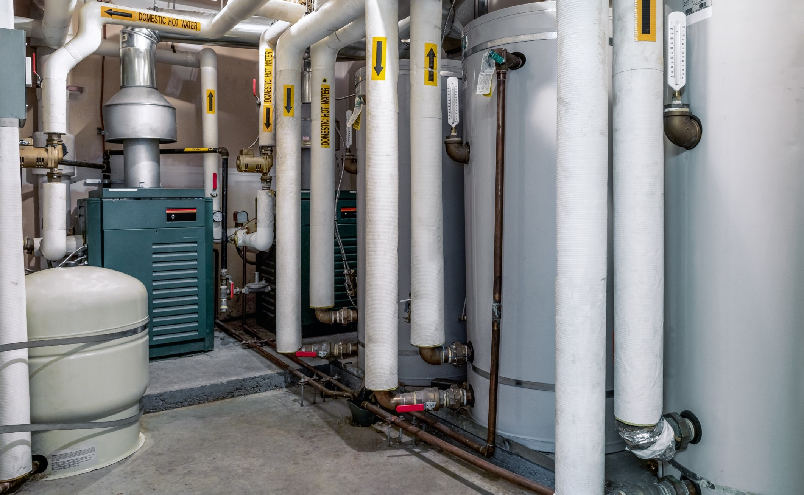



Gas Emerging Technologies (GET) Program
GAHP Pilot Phase 2
Site #2
2026
Notes:
CUES
Welcome. Title, names, roles. Not a product pitch. Q&A at the end.
SCRIPT
Good morning — thank you for joining. This is the Gas Emerging Technologies webinar for GAHP Pilot Phase 2, Site #2, September 2026.
I am [name] with [Lincus / ICF]. We are walking the Torrance hotel field site: how it was built, what the machine actually did, and what that means for gas savings and greenhouse-gas claims.
This is a measurement briefing, not a vendor presentation. Hold questions until the Q&A at the end unless something is blocking. Let's start with the agenda.

Slide 2
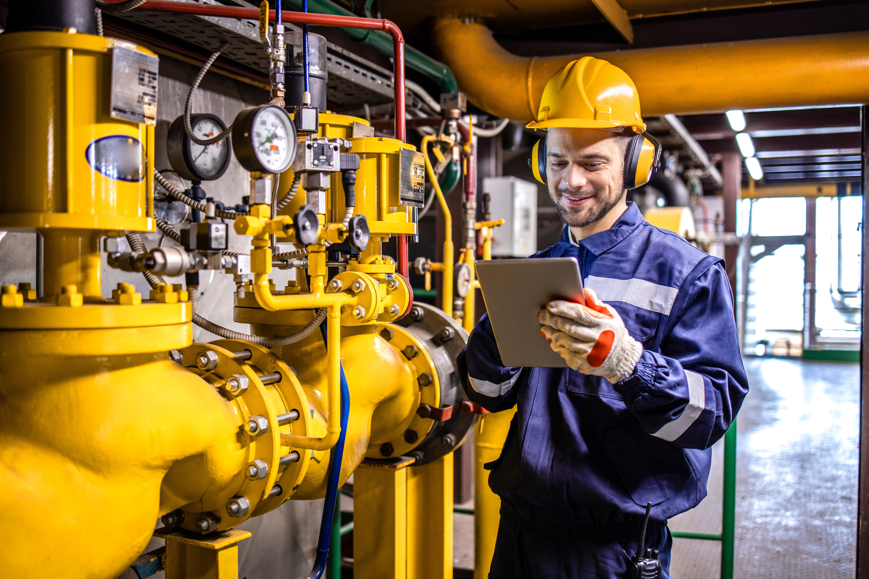
Agenda
Project Intro
How a GAHP Works
Why Consider GAHPs
Baseline System
Post System
Results
Lessons Learned
Q&A (15 minutes)

Slide 3
Project Intro

Slide 4
Project Intro — Phase 2 Site Portfolio
GET Phase 2 field-evaluates GAHP for base DHW production
This webinar covers Site #2 (medium travel hotel)
Site #2 (CZ06)
Type: Travel Hotel
Existing:
Site #3 (CZ09)
Type: Multifamily
Existing:
Site #4 (CZ09)
Type: Large Hotel
Existing:
Site #1 (CZ09)
Type: Multifamily
Existing:
Status: Installation complete
(2) 751 kBtu/h Instantaneous, 94%
(1) 250 kBtu/h direct fired + 100 gal storage, 94%
(2) 1,500 MBtu boilers+ 600 gal storage tanks
(1) 750 kBtu/h + 120 gal, 94%
(1) 650 kBtu/h + 120 gal, 84%
Status: Installation complete
GAHP → Robur
GAHP → Anesi
GAHP → Robur
Status: City Permit Review
GAHP → Anesi
Status: Installation complete
Notes:
CUES
Point at Site #2 card. Do not tour the other three.
SCRIPT
Phase 2 is four Anesi GAHP installations used as hybrid domestic-hot-water preheaters. This webinar is Site #2 only.
Site #2 is a 151-room hotel in Torrance. The existing plant is two 751 kBtu-per-hour condensing tankless heaters at 94 percent. The Anesi is in as a preheater. Installation is complete and we have been logging.
Site 1 and Site 3 are multifamily. Site 4 is another hotel, agreement signed, not the subject today.

Slide 5
How GAHPs Works

Slide 6
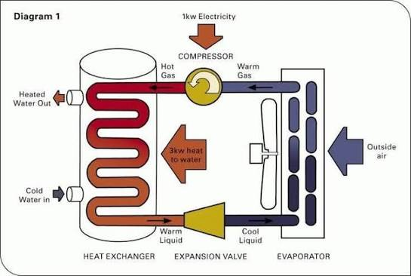
What are Heat Pump Water Heaters?

Slide 7
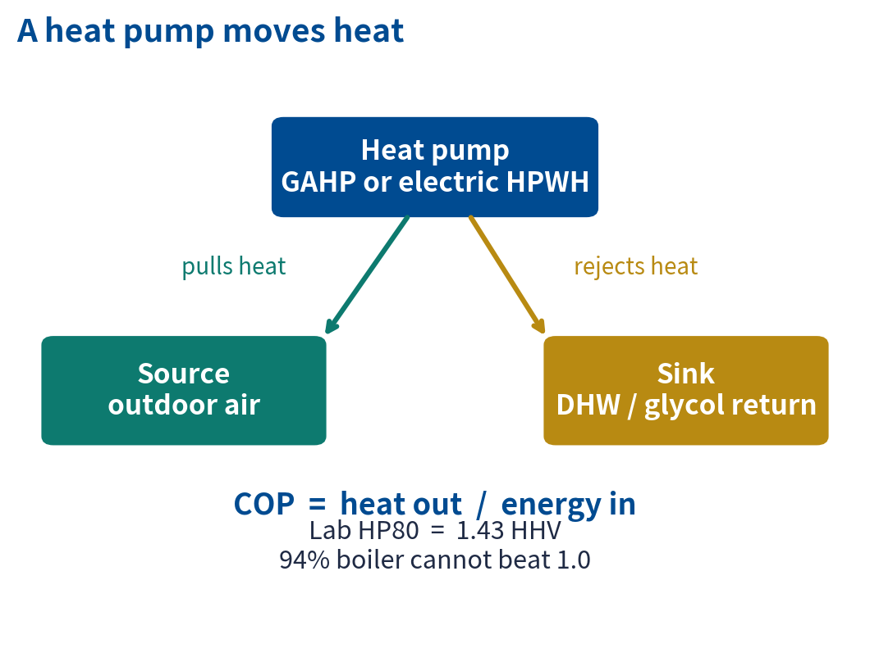
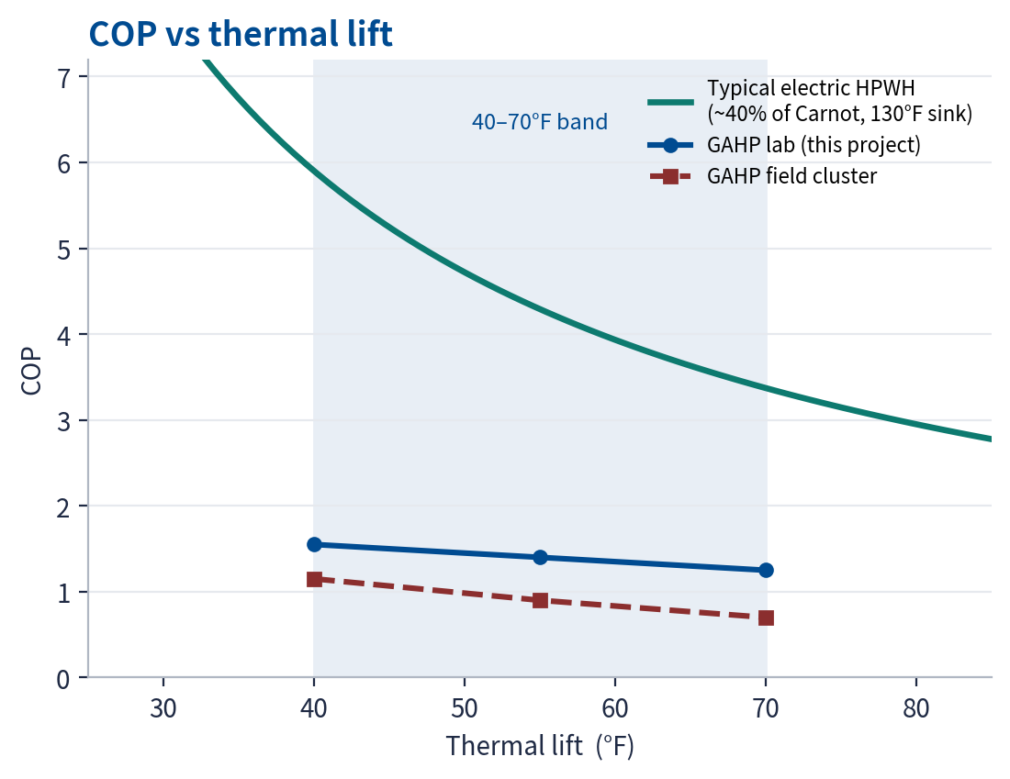
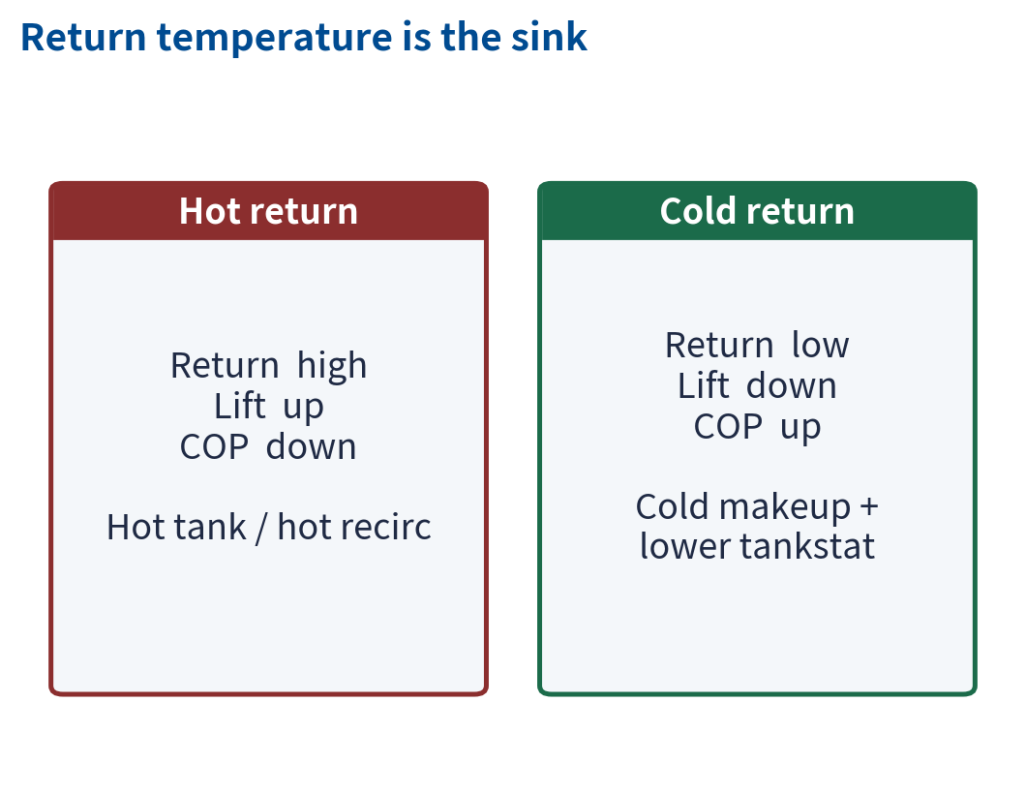
Heat Pump Water Heaters — Why Return Temperature Matters
COP falls as thermal lift rises. Low return temperature is how you keep lift down.
Typical electric HPWH ≈ 40% of Carnot at a 130°F sink. GAHP lab 1.2–1.6 and field 0.6–1.2 sit in the same 40–70°F lift band.
Notes:
CUES
~45 sec. Left: what a heat pump is. Center: COP vs lift. Right: return temp.
SCRIPT
A heat pump moves heat. Electric HPWH — compressor. GAHP — gas burner on an ammonia-water cycle. Heat out over energy in is COP. The lab Anesi is 1.43. A 94 percent boiler cannot beat 1.0.
The graph is the whole point. COP falls as thermal lift rises. The teal curve is a typical electric HPWH — about 40 percent of Carnot at a 130 degree sink. At 40 degrees of lift that machine is near COP 6. At 70 degrees it is near 3.
The navy and dashed red lines are this project's GAHP. Lab sits around 1.2 to 1.6 in that 40 to 70 degree band. Field sits lower — 0.6 to 1.2 — because of cycling and a hot return.
Lift is GAHP inlet minus outdoor air. Return temperature is the sink. Hot tank, lift up, COP down. Cold makeup and a lower tankstat, lift down, COP up. Same hardware, 13.4 percent versus 1.2 percent. That graph is why.

Slide 8
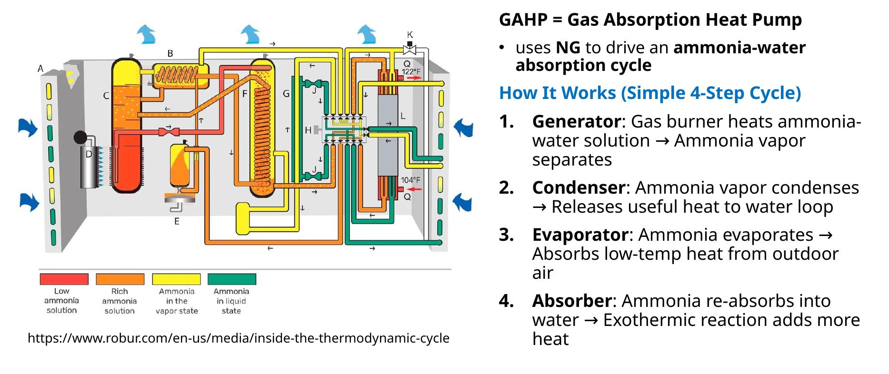
How GAHPs Work
GAHP = Gas Absorption Heat Pump
HOW: Thermally driven (via NG) using NH₃ as refrigerant and H₂O as the absorbent
How It Works (Simple 4-Step Cycle)
Generator: Gas burner heats ammonia-water solution → Ammonia vapor separates
Condenser: Ammonia vapor condenses → Releases useful heat to water loop
Evaporator: Ammonia evaporates → Absorbs low-temp heat from outdoor air
Absorber: Ammonia re-absorbs into water → Exothermic reaction adds more heat
GET Program | How a GAHP Works | Absorption cycle
Notes:
CUES
Burner not compressor. Ammonia / water. Lab COP 1.43 is not field COP.
SCRIPT
A GAHP is a heat pump driven by a gas burner instead of an electric compressor. Ammonia is the refrigerant. Water is the absorbent. The cycle is generator, condenser, evaporator, absorber.
The unit at this site is an Anesi HP80 — about 80 kBtu per hour out. The laboratory rating is a COP of 1.43 on higher heating value. In the field, some days reach above 1.50. What the field unit does not do is hold that high COP. Increased cycling on low-load hours pulls the daily and load-normalized COP back down. That gap — peak versus consistent — is the rest of this briefing.
Safety Regulations: Ammonia is toxic and highly pungent. Strict building codes (like IIAR Standard 2) place severe limits on how much ammonia charge can be placed near occupied spaces, making it heavily regulated for standard comfort cooling

Slide 9
Why Consider GAHPs

Slide 10
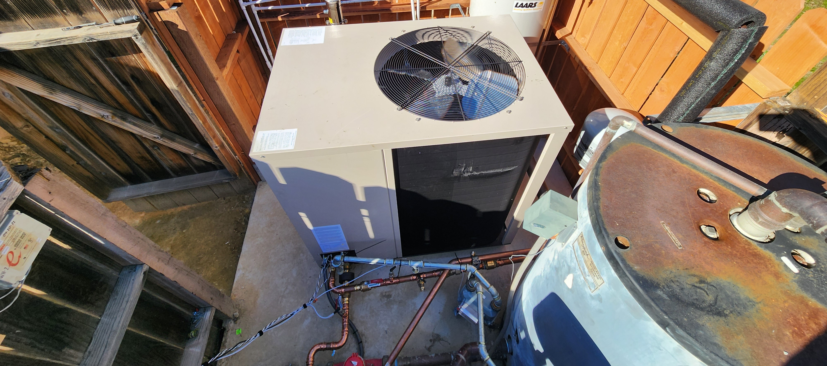
WHY: Gas-Fired Heat Pump Water Heater - Benefits
1. Decarbonization
2. Operating Cost
3. HTR Communities
Higher efficiency reduces energy consumption reducing emissions all hours. EHPWH* emissions fluctuate based on TOD
GHPWHs** save natural gas w/o adding substantial electric load. This saves $$ on DHW utility bills
(Hard-to-Reach) Decarbonization + reduction in utility bills
* EHPWH: Electric Heat Pump Water Heater
** GHPWH: Gas Heat Pump Water Heater
GET Program | Why Consider GAHPs | Benefits vs electric HPWH and boilers
Notes:
CUES
Three benefits only. Park source-CO2.
SCRIPT
Versus a boiler, a GAHP can deliver more heat per therm. Versus an electric heat-pump water heater, it uses ammonia — global warming potential zero — and it does not need a panel upgrade.
That is the installation case. It is not automatically the carbon case. We will put GAHP next to an electric HPWH on the 2024 Avoided Cost Calculator later. Do not take this slide as a CO2 ranking.

Slide 11
Previous GAHP Performance Highlights
NEEA (Salem)
  18% gas savings · COP 1.06 · strongest in mild climates
TAF (Toronto)
  20–50% gas reduction · 10.1 tonnes CO₂ saved/year
CEC (California)
  Up to 50% fewer NOx and GHG emissions · cost-effective at high-use sites
Key gap: every prior study was a combi system (DHW + space heat).
Phase 2 tests GAHPs on DHW-only plants — including Site #2.
Notes:
CUES
All prior studies were combi. Phase 2 is DHW-only.
SCRIPT
Prior field work is why this pilot exists. NEEA in Salem saw about 18 percent gas savings at a COP of 1.06, strongest in mild climates. TAF in Toronto reported 20 to 50 percent gas reduction. CEC work in California pointed at up to 50 percent fewer NOx and GHG at high-use sites.
The gap: every one of those was a combi system — domestic hot water plus space heat. Phase 2 puts GAHPs on DHW-only plants, including this hotel. That is why Site #2 can look different from those headlines.

Slide 12
Market Barriers and Field Pilot Objectives
Incentive today
  SoCalGas GAHP-for-DHW incentive exists for multifamily — and has not been used.
Barriers
  Low awareness of GAHPs and their carbon-reduction potential
  Limited contractor and engineer sizing expertise
  Uncertainty on operation and maintenance
  Thin performance and cost data for DHW-only plants
  No incentives for other building types (including hotels)
This pilot
  Field study launched to close those gaps and inform future GET / incentive design.
Notes:
CUES
Incentive exists for multifamily DHW. Lodging is the gap.
SCRIPT
The market barriers are not mysterious. People do not know the product. Few contractors size it. Operators do not know the maintenance. Incentives are uneven.
SoCalGas already has a GAHP-for-DHW incentive on the multifamily side. Lodging is the gap this hotel is testing. The pilot is here to produce field COP, controls guidance, and ACC emissions — not another lab curve.

Slide 13
Why water heating is the GET target
Water heating is the largest nonindustrial end-use of natural gas in California
Natural Gas Consumption by End Use in the Industrial, Commercial, and Residential sector
California Bills & Legislation
SB 1477 (Building Decarbonization/Space Heating/Water Heating)
California Long Term EE Strategic Plan (CLTEESP)
AB 758 (Comprehensive EE in Existing Buildings Law)
Focus sector: Multifamily (commercial)
Notes:
CUES
RASS context. Ten seconds.
SCRIPT
One context slide. Water heating is the largest non-industrial use of natural gas in California. That is why GET is in this end use. Let's look at the plant.

Slide 14
Baseline System

Slide 15
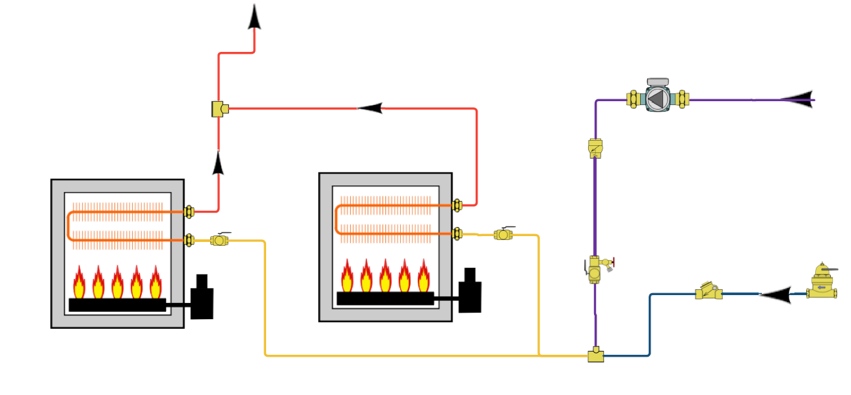
Baseline System — Site #2 Hotel DHW
Travel (Extended Stay) Hotel (CZ06)
  151-room / 4-story, 63,795 sf (renovated 2018)
Central DHW: (2) 751 kBtu/h modulating condensing tankless boilers, 94% TE
No storage tank — instantaneous plant
(1) constant-speed recirc pump, 1/16 HP, 24/7
1¼" return mixes with 3" city makeup
IPMVP Option B — all-parameter isolation
Hot Supply
Recirc Pump
Key Characteristics | Avg. Value
Daily Cold City Flow | 2500 GPD
Recirc Load Ratio | 30%
Return Water Temp | 120°F
DHW Setpoint | 130°F
Cold City Line
Notes:
CUES
Point at schematic while you list equipment.
SCRIPT
Site #2 is the Sonesta Select at 1925 West 190th Street in Torrance, climate zone 6. Four stories, 151 rooms, about 64,000 square feet.
The central DHW plant was two 751 kBtu-per-hour condensing tankless heaters, 94 percent rated, no storage tank. One constant-speed recirc pump, a sixteenth of a horsepower, runs 24/7. The inch-and-a-quarter return mixes with three-inch city makeup before the heaters.
We measured that plant under IPMVP Option B — retrofit isolation, all-parameter measurement.

Slide 16
Post System
Notes:
CUES
Installed plant.
SCRIPT
Post system. This is what we installed.

Slide 17
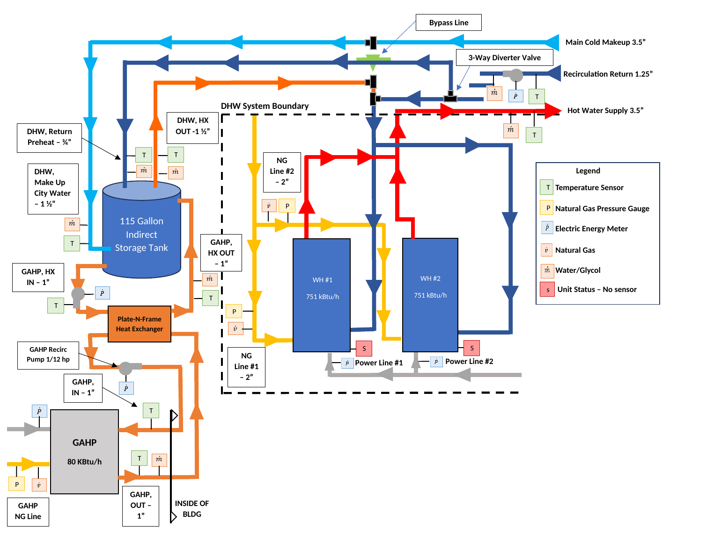
Post System — Anesi GAHP Hybrid Preheat
ANESI GAHP, 80 kBtu/h, outdoors on a glycol loop
Double-wall plate-and-frame HX to potable water (20 sq.ft.)
Heat-Flo 115-gal indirect storage tank (no coil)
Existing 751 kBtu/h tankless stay as peak / backup (heat recirc load)
GAHP outlet setpoint @140°F; Existing heaters setpoint @ 130°F
GAHP is the baseload preheater — not a full replacement
IST Tankstat adjustable (120-130°F)
Notes:
CUES
Preheat, not replacement. Point at GAHP, HX, 115-gal tank, two tankless.
SCRIPT
The Anesi sits outside on a glycol loop at 80 kBtu per hour. Heat crosses a double-wall plate-and-frame exchanger into a 115-gallon indirect tank. The two existing tankless heaters stay as peak and backup.
There is a three-way diverter on the recirc and a city-water bypass. We cap GAHP outlet near 140 degrees. The heaters hold about 130.
This is a baseload preheater. It is not a replacement for the tankless plant. If you remember one sentence from the design, remember that.
Safety Regulations: Ammonia is toxic and highly pungent. Strict building codes (like IIAR Standard 2) place severe limits on how much ammonia charge can be placed near occupied spaces, making it heavily regulated for standard comfort cooling

Slide 18
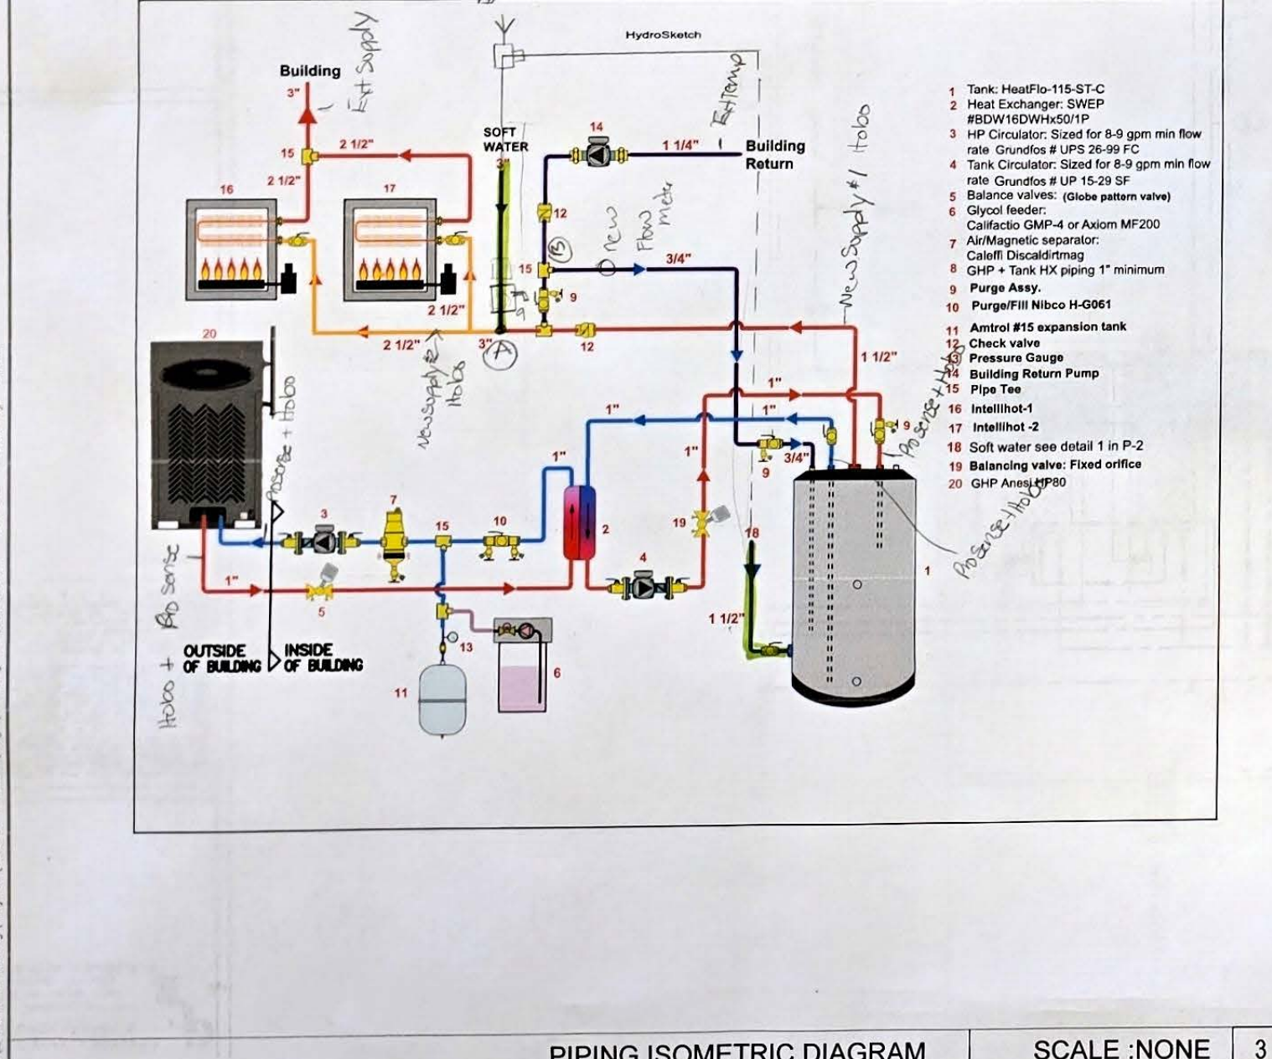
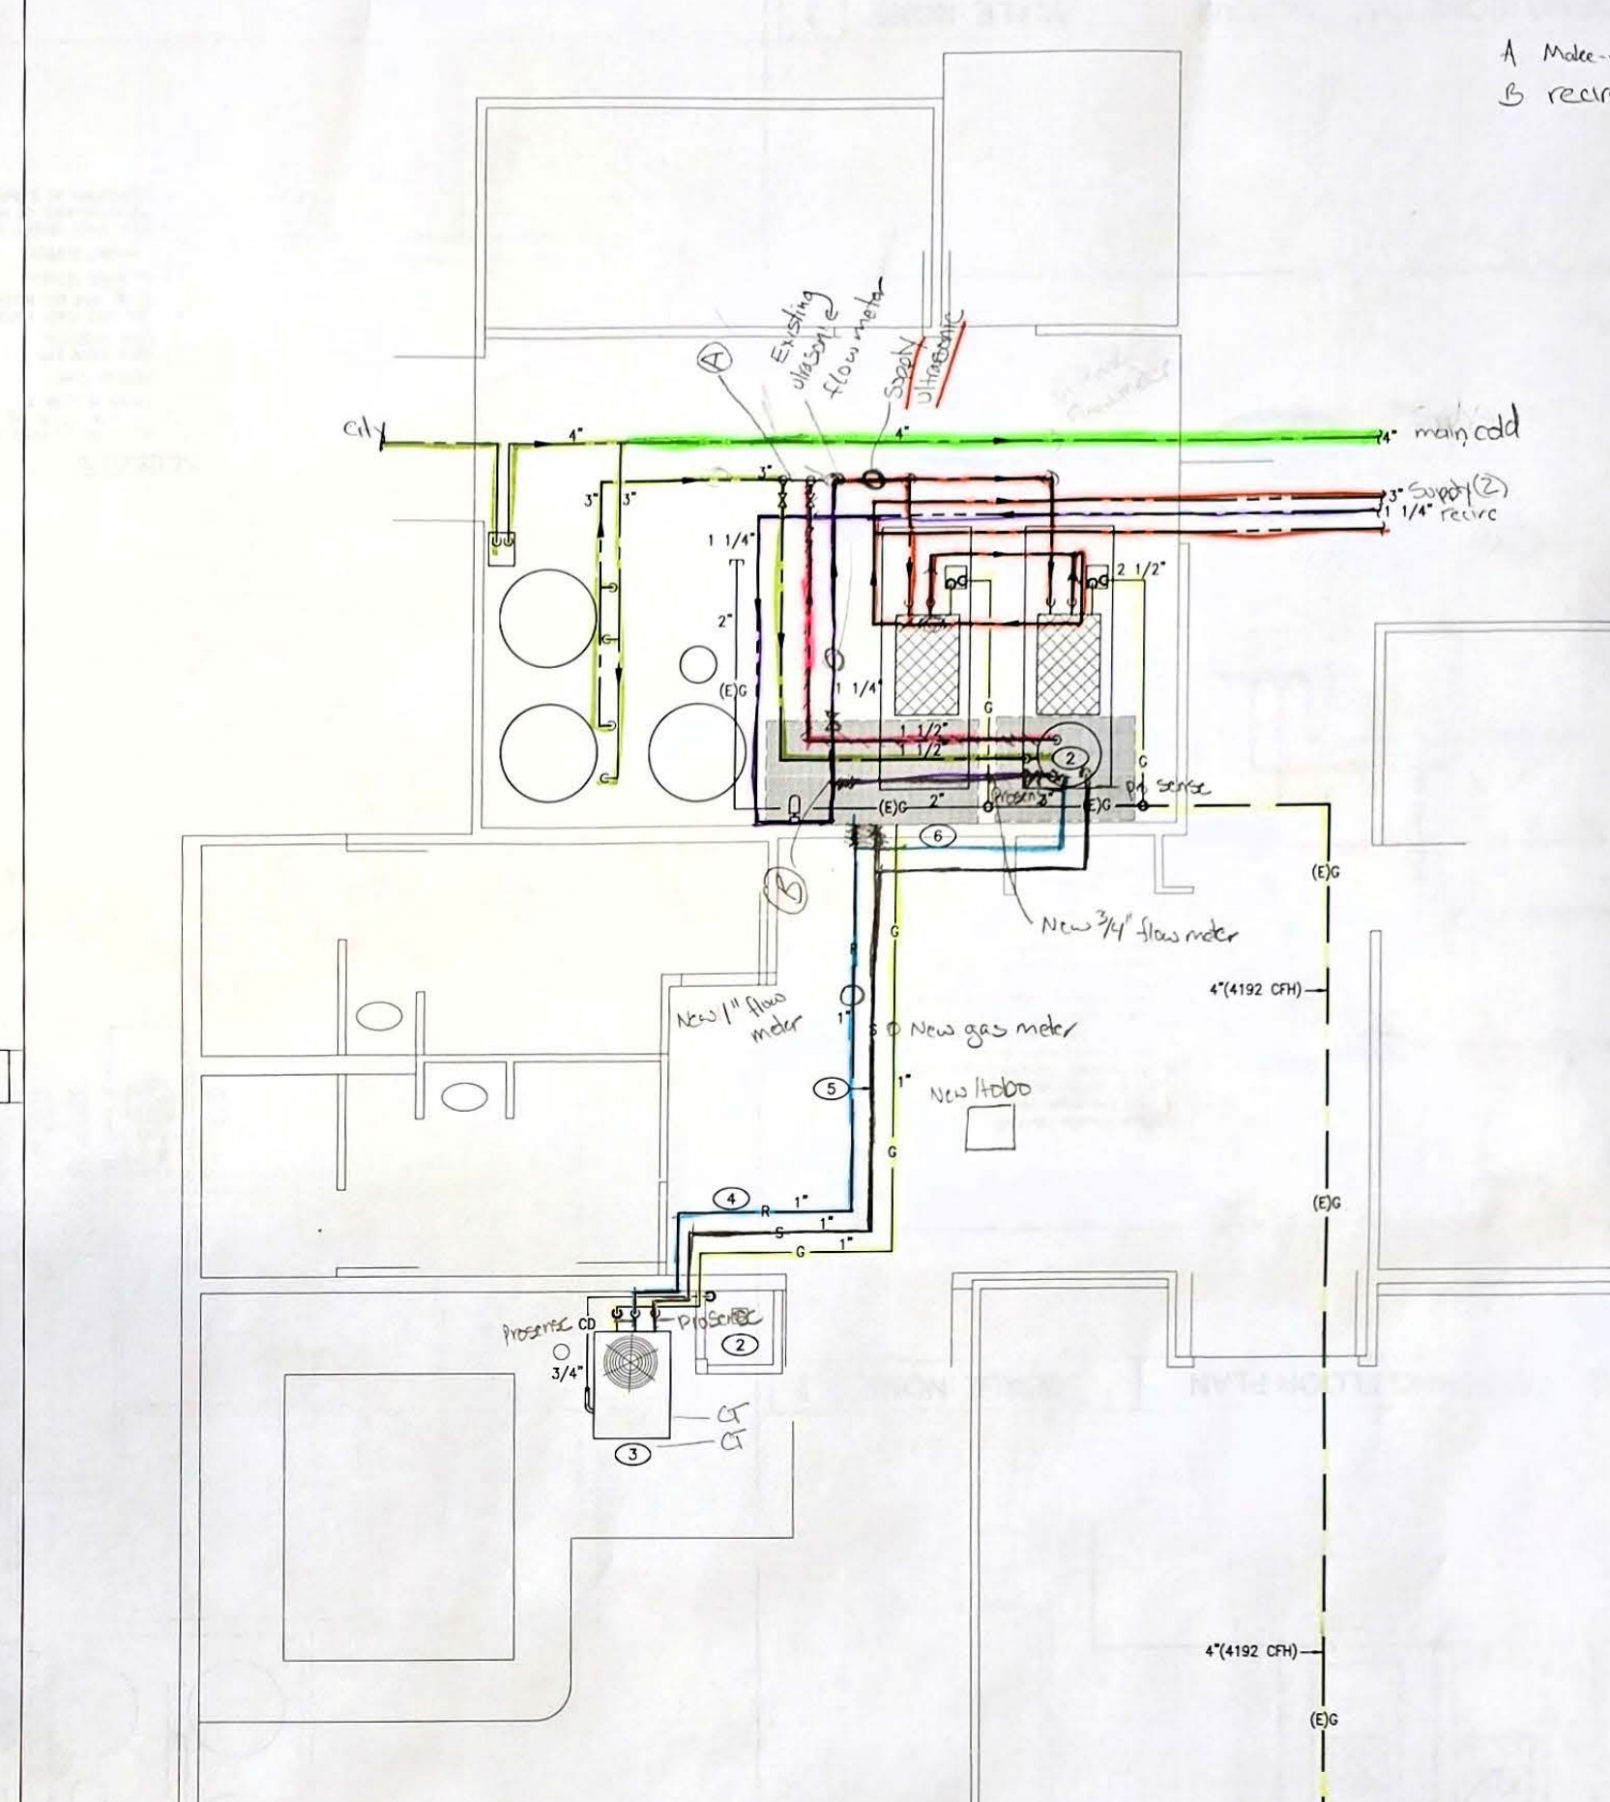
Engineering Design / Permitting Drawings — P-1
Sonesta Select Water Heating Modification · 1925 W 190th St, Torrance
2.0 m² (21.2 ft²
2.0 m² (21.2 ft²
Piping isometric — GAHP, HX, 115-gal IST, existing tankless
Piping floor plan issued for permit / installation
Notes:
CUES
Permit set. Left iso, right floor plan.
SCRIPT
This is P-1 from Gevork Consulting — Sonesta Select water-heating modification — the sheet that went to permit.
On the left is the piping isometric: GAHP outside, heat exchanger, 115-gallon tank, two tankless. On the right is the floor plan as installed at 1925 West 190th. If someone asks whether this cleared plan check, this is the drawing that did.

Slide 19
Plate-and-Frame HX Sizing — SWEP SSP
Anesi sized the HX from expected DHW load and HX temps. Optimal LMTD = 6°F. Rule of thumb: ~1 sq.ft area per kBtu/h (~80 sq ft).
1. SWEP SSP online tool
2. Design basis (HP80)
3. Selected HX
Load ≈ 80 kBtu/h GAHP
Optimal LMTD = 6°F per Anesi GAHP manual
LMTD too high → COP decreases
LMTD too low → cost & fouling
Double-wall required; max ΔP ~2 psi either side
SWEP BDW16DWHX50/1P
BDW16DW = double-wall brazed plate
HX50 = 50 plates 1P = one pass
Sq. Ft = 2.0 m² (21.2 ft²)
316/316L plates, copper brazed
Chosen by Anesi from expected load and HX ΔT
Listed in Anesi CWH bulletin as the HP80 DW option
SWEP SSP / DThermX — software used by mfg
Inputs: DHW load, estimate HX Temps
Hot side: 20% propylene glycol
Cold side: potable DHW
Counterflow, one-pass
Tool returns model + plate count that meet load and ΔP
Field: 6°F LMTD on the change matrix is an operating window; design LMTD is 4°F. Close to 80 sq ft of HX area would have been optimal to hold GAHP efficiency at low and high load. When field LMTD ran ~10°F, COP and savings collapsed.
Notes:
CUES
~45 sec. After the post-system schematic. Land on 4°F LMTD and the 80 sq ft rule of thumb.
SCRIPT
The plate-and-frame exchanger was not picked off a catalog page. Anesi sized it in SWEP SSP — the manufacturer's online selection tool — using the expected HP80 load and the temperatures across both sides of the exchanger.
You enter heat load, glycol and potable inlet and outlet temperatures, and a pressure-drop limit. SSP returns a model and a plate count.
The Anesi GAHP manual sets optimal LMTD at 6 degrees. That is the design target. If LMTD runs high, the glycol comes back to the GAHP too hot and COP falls. That is what we saw in the field when LMTD sat near 10 degrees.
What we would do next time is size the HX on a simple rule of thumb from this site: about one square foot of exchanger area per kBtu per hour of GAHP output. For an 80 kBtu-per-hour Anesi, that is close to 80 square feet. That area is what keeps LMTD in range at both low load and high load.
The selected unit is a SWEP BDW16DW HX50 one-pass — fifty double-wall plates. Double-wall is required between glycol and potable water.
Log Mean Temperature Difference (LMTD) & Velocity Limits — The Thermodynamic Limit
Minimum Velocity (Fouling Prevention): To get a low LMTD (like 4°F to 6°F), you need a large surface area. If you achieve this by adding too many parallel plates, the fluid velocity inside each channel drops too low. If the velocity drops below roughly 1 to 1.5 ft/s, the flow loses its turbulence. Without turbulence, minerals in the city water rapidly drop out of suspension, scaling up the plates and ruining heat transfer.
Maximum Velocity (Erosion Prevention): Conversely, if you force too much water through too few channels to keep turbulence high, velocities exceeding 10+ ft/s will physically erode the stainless steel plates over time

Slide 20
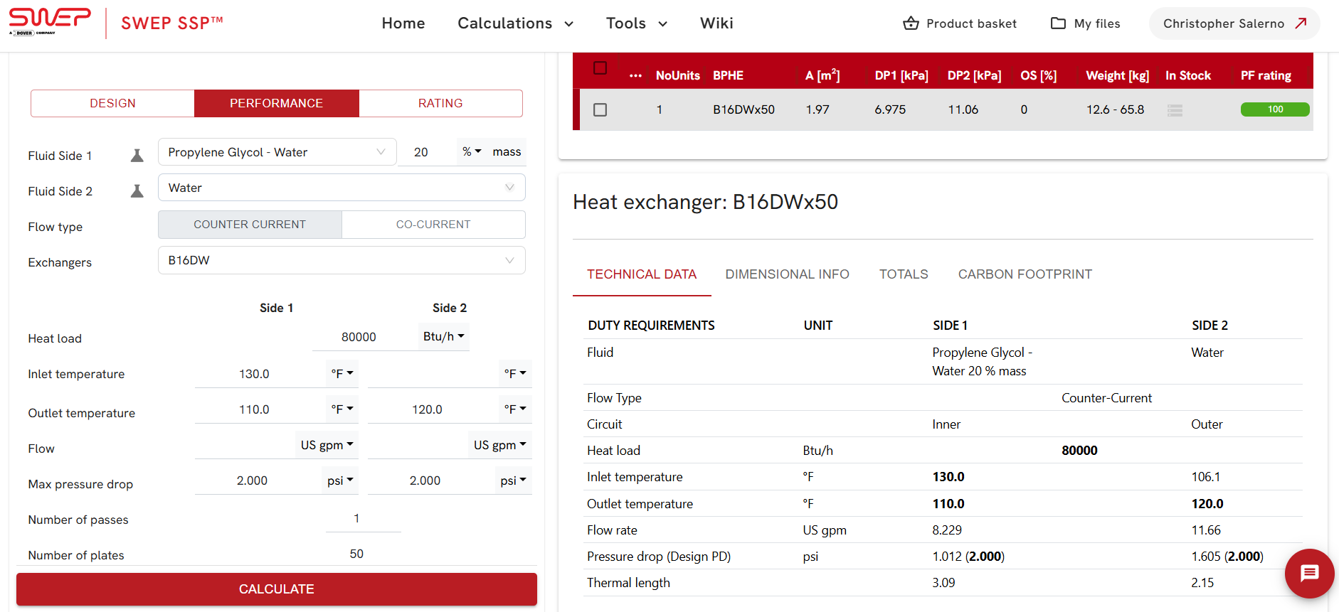
SWEP DThermX Online Sizing Tool
Updated Rule of thumb:
~1 sq ft HX per kBtu/h (~80 sq ft)
Notes:
SCRIPT
The plate-and-frame exchanger was not picked off a catalog page. Anesi sized it in SWEP SSP — the manufacturer's online selection tool — using the expected HP80 load and the temperatures across both sides of the exchanger.
You enter heat load, glycol and potable inlet and outlet temperatures, and a pressure-drop limit. SSP returns a model and a plate count.
The Anesi GAHP manual sets optimal LMTD at 4 degrees. That is the design target. If LMTD runs high, the glycol comes back to the GAHP too hot and COP falls. That is what we saw in the field when LMTD sat near 10 degrees.
What we would do next time is size the HX on a simple rule of thumb from this site: about one square foot of exchanger area per kBtu per hour of GAHP output. For an 80 kBtu-per-hour Anesi, that is close to 80 square feet. That area is what keeps LMTD in range at both low load and high load.
The selected unit is a SWEP BDW16DW HX50 one-pass — fifty double-wall plates. Double-wall is required between glycol and potable water.

Slide 21
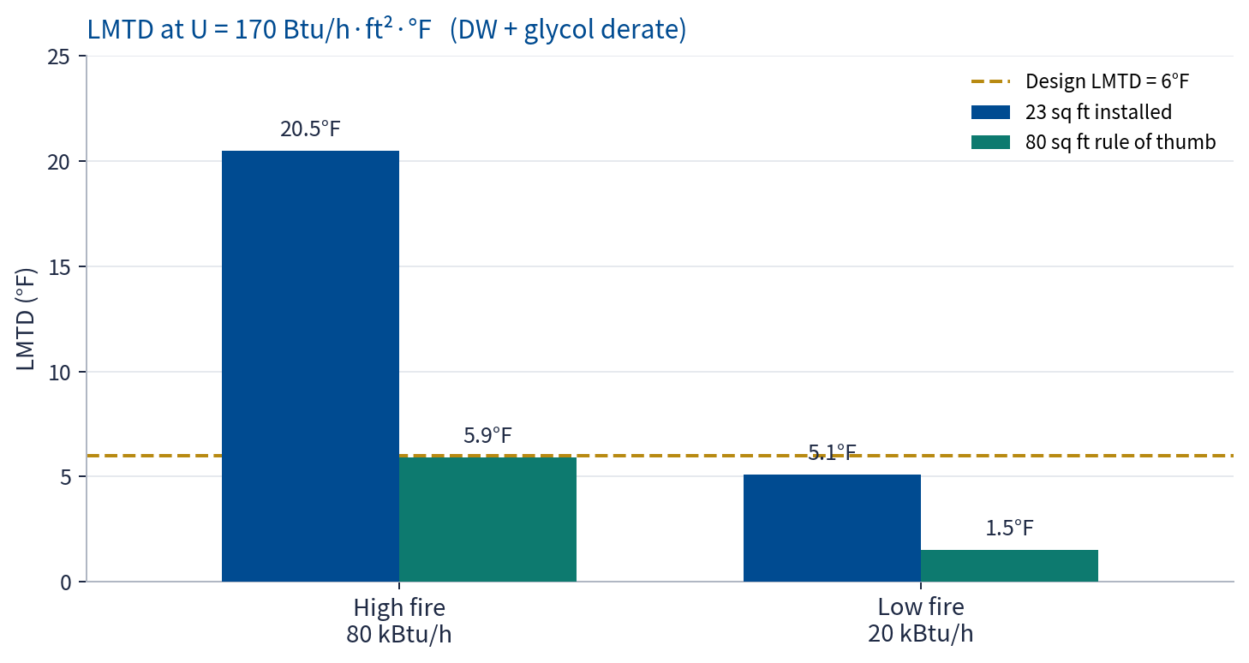
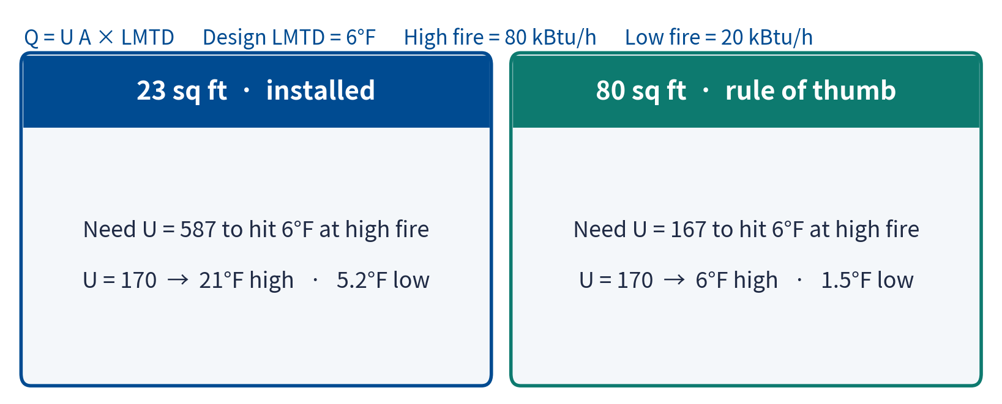
HX Rule of Thumb — Critical Sizing for High + Low Load
~1 sq ft per kBtu/h of GAHP → ~80 sq ft for the HP80. Design LMTD = 6°F. Installed pack ≈ 23 sq ft.
Pros
High-fire LMTD stays on 6°F when U drops. Low-fire LMTD 1.5°F vs 5.2°F — colder return, less cycling.
Cons
Cost, footprint, glycol. Leaves the tested 50-plate SWEP. Area cannot fix a 110°F / 5 gpm pinch.
***Low fire: 23 sq ft can still hit ~6°F if U holds. 80 sq ft is the high-fire derated-U target, with extra low-load headroom.***
Notes:
CUES
~40 sec. Point at the two packs, then the bars. High fire first, then low fire.
SCRIPT
The rule is one square foot of exchanger per kBtu per hour of GAHP. For the HP80 that is about 80 square feet. Design LMTD is 6 degrees. The installed SWEP is about 23.
Required UA at high fire is 80,000 over 6 — 13,333. That is a U of 587 on 23 square feet, or 167 on 80.
Look at the bars, U equals 170. High fire: 23 square feet needs about 21 degrees of LMTD. 80 square feet lands on 6. Low fire: 23 square feet is 5.2 degrees — on target if U holds. 80 square feet is 1.5 degrees. That extra drop is colder glycol return and less cycling.
Field high-fire LMTD near 10 degrees says the installed pack was closer to U of 350. Same U on 80 square feet would have been about 3 degrees.
Pros: high-fire LMTD stays on 6 when U drops. Cons: cost, footprint, leaving the tested 50-plate unit — and area cannot fix a pinch if the tank is already 110 degrees at 5 gallons a minute.

Slide 22
Results
Notes:
CUES
Field data, not the spec sheet. Slow down on the change matrix.
SCRIPT
Field results — not the specification sheet. You will see days above a 1.50 COP. You will also see why that number does not stick: low load and increased cycling. We slow down on the change matrix and the thermal-lift plot.

Slide 23
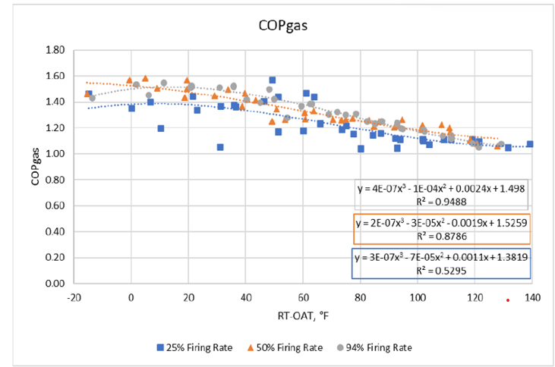
GAHP Field vs Lab COP vs GAHP Inlet - OAT
Most field points sit at COP 0.6–1.2 in the 40–70°F lift band. Lab in the same band is 1.2–1.6. Some days reach or exceed the 1.43 rated COP; the unit does not hold that high COP the way the lab unit does.
range
40-60°F
Field COP
0.6-1.4
range
40-60°F
Lab COP
1.2-1.6
Avg. Field % Firing Rate = 73%
vs.
Steady State @ 50%, 94% Firing Rates
Notes:
Most field points sit at 0.6–1.2 in the 40–70°F lift band. Lab in that band is 1.2–1.6. Some days reach above 1.50 — past the 1.43 rating. The field unit does not maintain those high COPs. Increased cycling on low-load hours is why the cluster sits below the lab curve.

Slide 24
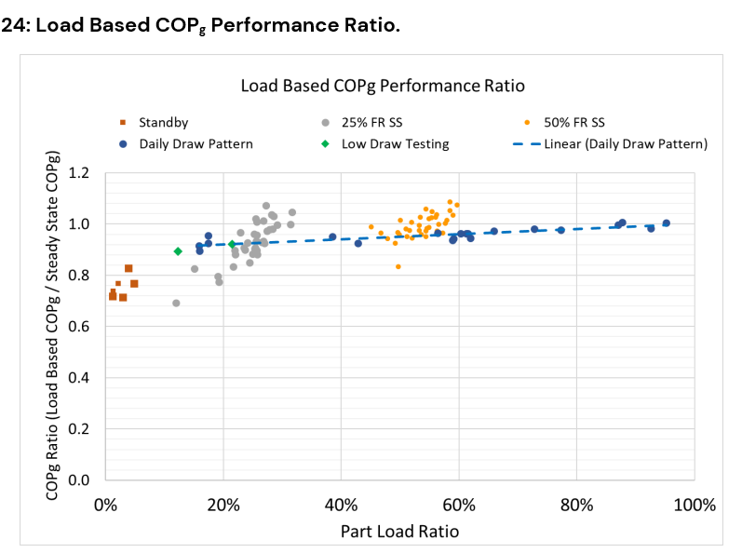
Field vs Lab Load Based Results
Field vs lab load-based COP
Above ~60% part load, field COP ratio is 0.8–1.0. Below that, COP falls off. Short-cycling and low-load hours are why daily COP is not the nameplate.
Notes:
Above ~60% part load, field ratios are 0.8–1.0. Below that, COP falls off. On low-load hours the GAHP short-cycles. Instantaneous COP can still look strong; daily COP does not.

Slide 25
Tank-to-HX Inlet Temperature/COP vs % Part Load
Trends:
% Part Load ↑
(increased demand)
Tank-to-HX Inlet Temp ↓
(Colder city water draw)
GAHP COP ↑
(reduces GAHP return)

Slide 26
Hourly Performance Profile
Hourly Performance Profile
Hotel DHW peaks morning and evening. Those hours have to pay for the GAHP. Off-peak hours are where part-load and high LMTD hurt COP.
Notes:
Comment: ask GTI tmw morning what is the daily draw pattern vs low draw?
How can be axis be mathed?
Circle points on both chartst aht match up, such as

Slide 27
Gas savings vs thermal lift
Hourly Performance Profile
Savings fall as lift rises. The 13.4% point is the lowest-lift / best-control window — not an annual number. Stay on this chart if asked for “the” savings figure.
Trends:
Overall Gas Savings ↑
(baseline vs post)
Thermal Lift ↓
(GAHP Inlet Temp - OAT)
GAHP COP ↑
(reduced thermal lift)

Slide 28
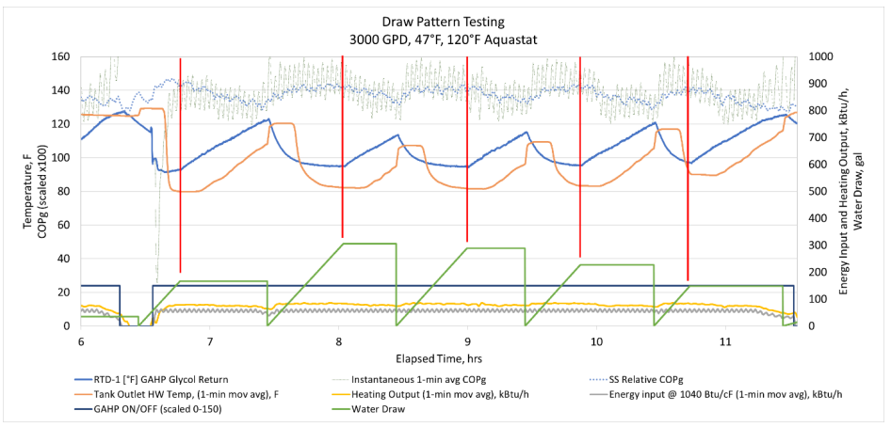
Lab Draw Pattern Testing, Impacts on Instantaneous COPg
Lab draw tests show the same part-load shape. The field cluster is not one bad week.
Instantaneous COP drops from:
GAHP cycling
lowered RWT (~25°F)
COP Drops

Slide 29
Field instantaneous COP snapshot
Instantaneous COP is not daily COP. Some snapshots hit or exceed 1.43; load-normalized daily COP is what we take into savings.
Daily Performance Metrics
Daily Cold City Draw | 3760
Daily GAHP COP | 1.31

Slide 30
GHG Implications — 2024 ACC Avoided Emissions
Same Site #2 DHW load · CPUC 2024 Avoided Cost Calculator avoided emissions · vs existing tankless baseline
Baseline tankless
Site #2 GAHP hybrid
Electric HPWH (same load)
• Existing (2) 751 kBtu/h condensing units
• Reference case — 0% reduction
• All DHW heat from on-site gas
• ACC avoided emissions = baseline
• Overall avoided emissions: −5.46%
• Cuts gas without electrifying the plant
• Ammonia/water refrigerant, GWP = 0
• No new electric peak or panel work
• Savings persist every hour of the day
• Overall avoided emissions: −22.12%
• ~4× the ACC CO₂e reduction of GAHP
• Moves the load onto the CA grid
• Needs panel / service capacity
• HFC refrigerant on most commercial units
Takeaway: under the 2024 ACC, a same-load electric HPWH avoids more CO₂e at Site #2 (−22.12%) than the GAHP hybrid (−5.46%). GAHP still reduces avoided emissions and on-site gas without a panel upgrade. Do not claim GAHP beats EHPWH on ACC CO₂e at this site.
Source: ET24SWG0006 MS05b preliminary analysis (2026-09-12), CO₂ emissions sheet — 2024 ACC avoided emissions.
Notes:
CUES
Read the two percentages once. Do not claim GAHP beats EHPWH on ACC.
SCRIPT
Greenhouse-gas comparison on the official yardstick: the 2024 CPUC Avoided Cost Calculator, same Site #2 hot-water load, versus the existing tankless baseline.
The GAHP hybrid reduces overall avoided emissions by 5.46 percent. A same-load electric heat-pump water heater reduces them by 22.12 percent — about four times the GAHP reduction at this site.
Say that plainly. GAHP still cuts gas and ACC emissions, uses a GWP-zero refrigerant, and does not need a panel upgrade. What we will not claim is that GAHP beats an electric HPWH on 2024 ACC carbon at Site #2.
Source is the ET24SWG0006 MS05b preliminary analysis, September 12, 2026, CO2 emissions sheet.

Slide 31
What These Findings Mean
For GET / IOUs
  DHW-only GAHPs save gas when thermal lift and LMTD stay in range — control is the measure.
  Best field window was 13.4% load-normalized gas savings.
For decarbonization claims
  2024 ACC avoided emissions at Site #2: GAHP −5.46% vs electric HPWH −22.12%.
  GAHP still cuts on-site gas and ACC emissions without shifting peak load onto the grid.
For the next sites
  Lock dynamic tankstat / high-load-only operation so more hours look like the 13.4% window.
  Keep ACC avoided-emissions and field COP side-by-side in the final report.
Notes:
CUES
Three takeaways only.
SCRIPT
Three things to take from this site.
For GET: DHW-only GAHPs save gas when lift and LMTD stay in range. Control is the measure. The 13.4 percent best window is real load-normalized savings. It is not the lab COP of 1.4.
For decarbonization claims: 2024 ACC avoided emissions at Site #2 are GAHP minus 5.46 percent versus electric HPWH minus 22.12 percent. GAHP still cuts on-site gas without moving peak load onto the grid.
For the next sites: lock dynamic tankstat and high-load-only operation so more hours look like the 13 percent window, not the 1 percent window. Keep ACC emissions and field COP side by side in the final report.

Slide 32
Lessons Learned
Notes:
CUES
Two lessons.
SCRIPT
Lessons learned. Two we would not skip on the next hotel.

Slide 33
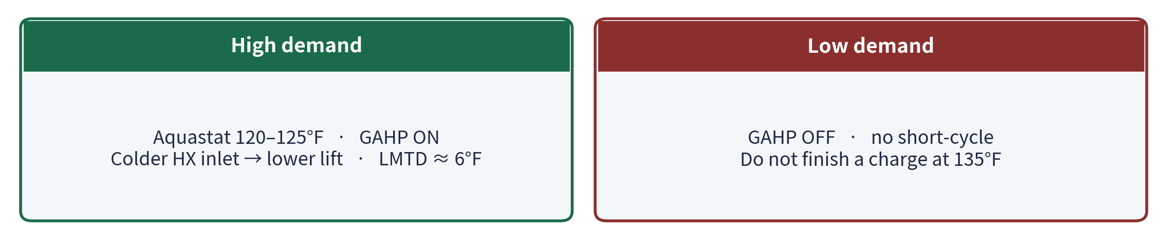
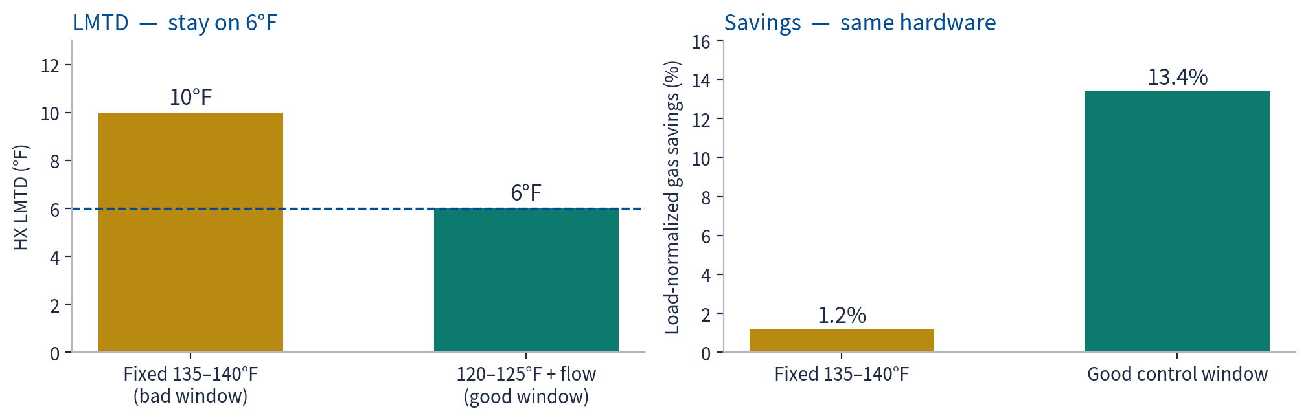
IST Aquastat — Lower Lift, Don’t Raise LMTD
Colder return at high load. GAHP off at low load. HX LMTD stays at 6°F.
Notes:
CUES
~35 sec. Modes first, then the two bars.
SCRIPT
The aquastat idea is right. We do not raise LMTD. Design is 6 degrees. Ten degrees was the 1.2 percent window.
High demand: tankstat 120 to 125, GAHP on. Colder water into the exchanger, lower lift, LMTD held at 6. Low demand: GAHP off. Do not finish a charge at 135. That tank is a hot sink for the next cycle.
Same hardware. LMTD from 10 down to 6. Savings from 1.2 percent to 13.4 percent.

Slide 34
Other Recommendations — Next 30 Days and Next Site
If only one test runs: 120–125°F + high-load enable, then re-measure for 30 days.
1. Prove the window
2. Size the sink
3. Stop overnight cycling
• 30-day A/B vs fixed 135–140°F
• Report savings, daily COP, cycles, LMTD
• Add min-run / anti-short-cycle
• Next HX ≈ 80 sq ft (1 sq ft / kBtu/h)
• SWEP SSP at 6°F and U ≈ 170
• Commission diverter and balance valves
• Occupancy / GPD enable
• Outdoor-reset trial on Sites 3–4
• Tankless covers the off-peak loop
4. Annualize, don’t headline
5. Write the sequence
6. Keep carbon honest
• Weight 13.4% and 1.2% by GPD
• Load-normalized only — no weather stack
• Keep 13.4% labeled as a window
• Lodging GAHP control spec for the incentive
• Tankstat band, enable, LMTD alarm
• optimized controls per site design
• ACC 2024: GAHP −5.46%, EHPWH −22.12%
• GAHP case is gas + zero-GWP + no panel
• Do not claim ACC CO₂e leadership
Notes:
CUES
~35 sec. Point at card 1. Name 2 and 3. Skip 4–6 if short.
SCRIPT
Six follow-ups. If only one runs, it is card one: 30 days of 120 to 125 and high-load enable versus the fixed 135 to 140 aquastat. Report load-normalized savings, daily COP, cycle count, and LMTD. Add a minimum run time.
Card two is the next hotel — 80 square feet of exchanger, commissioned flow. Card three is occupancy enable so the unit does not cycle overnight.
Annualize the two windows by GPD before anyone quotes 13.4 percent as a year. Write the lodging sequence into the incentive. And keep the ACC pair on the table — 5.46 versus 22.12. The GAHP case is gas, zero-GWP refrigerant, and no panel. It is not ACC carbon leadership at this site.

Slide 35
Q&A (15 minutes)
Notes:
CUES
Controls and ACC first if time is short.
SCRIPT
Questions. If we parked anything, we will take those first. If time is short, start with controls and the ACC comparison. We have 15 minutes.

Slide 36


For More Information
Visit CAGasTech.com or contact the GET Program for support and questions.
E: GET@CAEnergyPrograms.com
ICF is a SoCalGas authorized contractor responsible for implementing this program through 12/31/2027.
The Statewide Gas Emerging Technologies Program (GET) is funded by California utility customers and administered by SoCalGas and supported by the state’s other investor-owned utilities, (IOUs) SoCalGas®, San Diego Gas & Electric (SDG&E®), and Pacific Gas and Electric Company (PG&E®) under the auspices of the California Public Utilities commission through a contract awarded to ICF. Program funds, including any funds utilized for rebates or incentives, will be allocated on a first-come, first-served basis until such funds are no longer available. This program may be modified or terminated without prior notice. Customers who choose to participate in this program are not obligated to purchase any additional goods or services offered by ICF or any other third party. The selection, purchase, and ownership of goods and/or services are the sole responsibility of customer. None of the above-mentioned investor-owned utilities (IOUs) make any warranty, whether express or implied, including the warranty of merchantability or fitness for a particular purpose, of goods or services selected by customer. None of the IOUs endorse, qualify, or guarantee the work of ICF or any other third party. Eligibility requirements apply; see the program conditions for details.
© 2026 ICF Resources, LLC. The trademarks used herein are the property of their respective owners. All rights reserved. Some materials used under license, with all rights reserved by licensor.
© 2026 ICF Resources, LLC
Message funded by ratepayers
Notes:
CUES
Leave the URL up. Stop talking.
SCRIPT
More information is at CAGasTech.com, or email the GET program. Thank you to SoCalGas, ICF, Lincus, Enovative, and the Sonesta facilities team.
I will leave this slide up. Happy to take any last questions.

